Slide 1
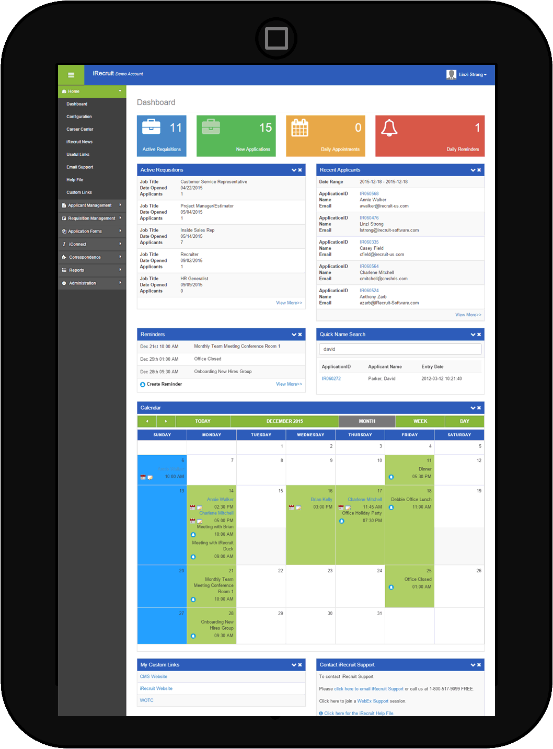
How iRecruit works
Cloud-based Software as a Service (SaaS)
No Long-Term Contract: Pay as you go monthly.
Your own Career Site
Unlimited Job Postings & Unlimited Candidates
New Design for your Smart phone/Tablet/Browser
Straight forward setup or Enterprise system
ATS only or iConnect – Complete Electronic Onboarding
Full Sage HRMS & Payroll integration
completes workflow.
1

Slide 2
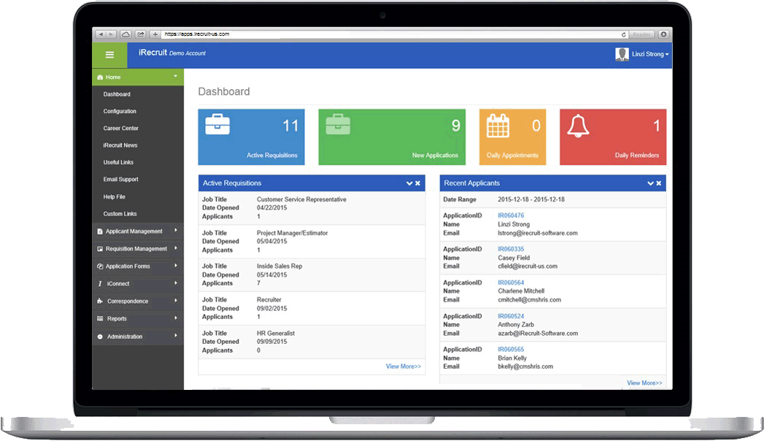
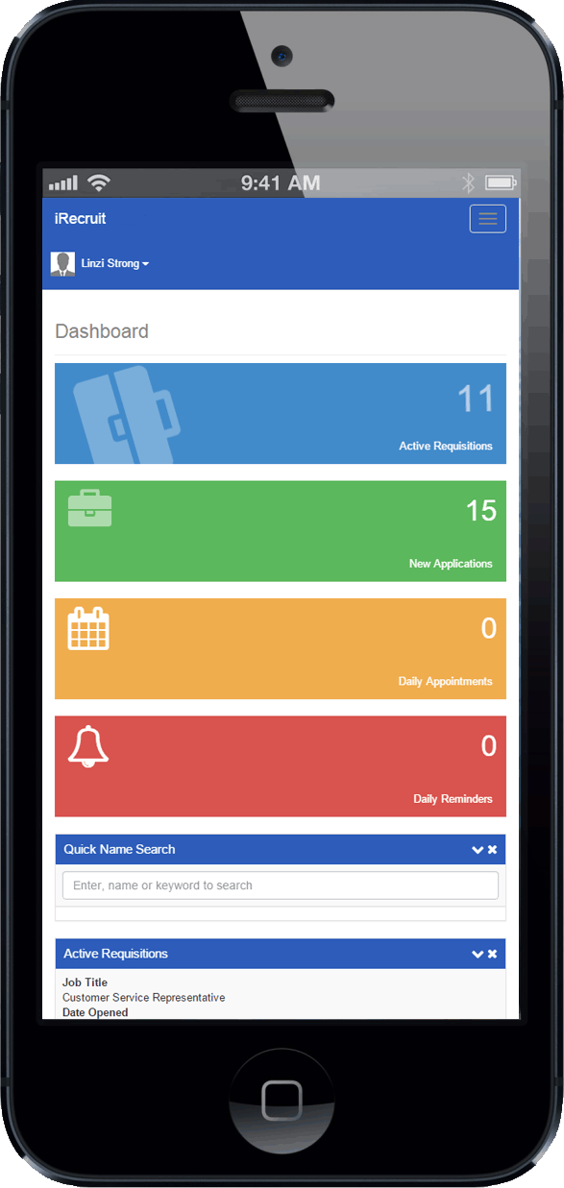
How iRecruit works
2

Slide 3
iRecruit Sophistication & Simplicity
Unlimited amount of job postings
Automatically post to your iRecruit account
Automatically shared with Indeed.com and SimplyHired.com
Post to LinkedIn, Twitter and Facebook
Post to Monster.com
Track workflow and report on applicants
Respond to applicants by email
3

Slide 4
Advertising and Branding with iRecruit
Expanding advertising to multiple sources
Automatically shared with Indeed.com
New iRecruit – Job Board Refresh
Post to LinkedIn, Twitter and Facebook
New use LinkedIn profile to apply easier
Use LinkedIn groups to promote referrals
Use YouTube for better SEO ratings
New Monster integration to both paid account & new organic site
6

Slide 5
Engage Hiring Managers
Give access to account where Hiring Managers can view and manage their candidates through the hiring process.
OR
Engage Hiring Managers via email. As you forward applicant data via email, Hiring Managers can Approve or Reject candidates with comments.
4

Slide 6
Job Requisition Options
Simple Requisition: No Approval Required.
Requisition Approval Workflow:
Hiring Manager
Initiates Request
Approver(s) assigned by HR Recruiters
Approver(s) Receive
Request via Email
Approved Jobs
Appear on Website
5

Slide 7
Find the right candidate with iRecruit
Jobs automatically distributed to Indeed/SimplyHired to attract candidates – Free with service!
Sponsored Advertising addtional
Pre-screening questions to easily identify qualified candidates.
Search tools and reporting to find the right candidate by skill, experience, education etc.
7

Slide 8
iConnect Workflow
Applicant is
Hired
New Hire Forms
Automatically
Assigned
New Hire
Completes
“Paperwork”
Online
Hiring Manager
Approves
Paperwork
Onboard
To HR
System
10

Slide 9
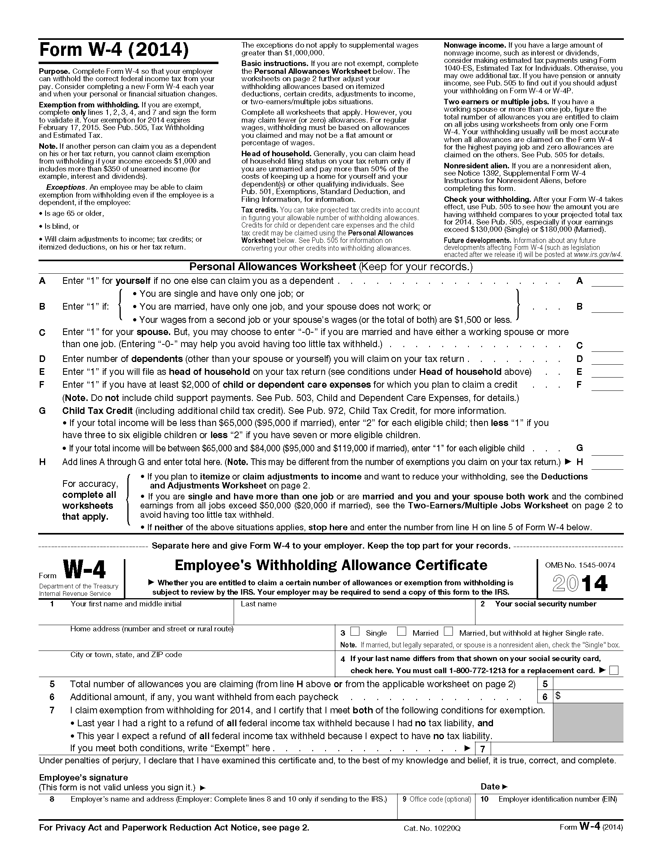
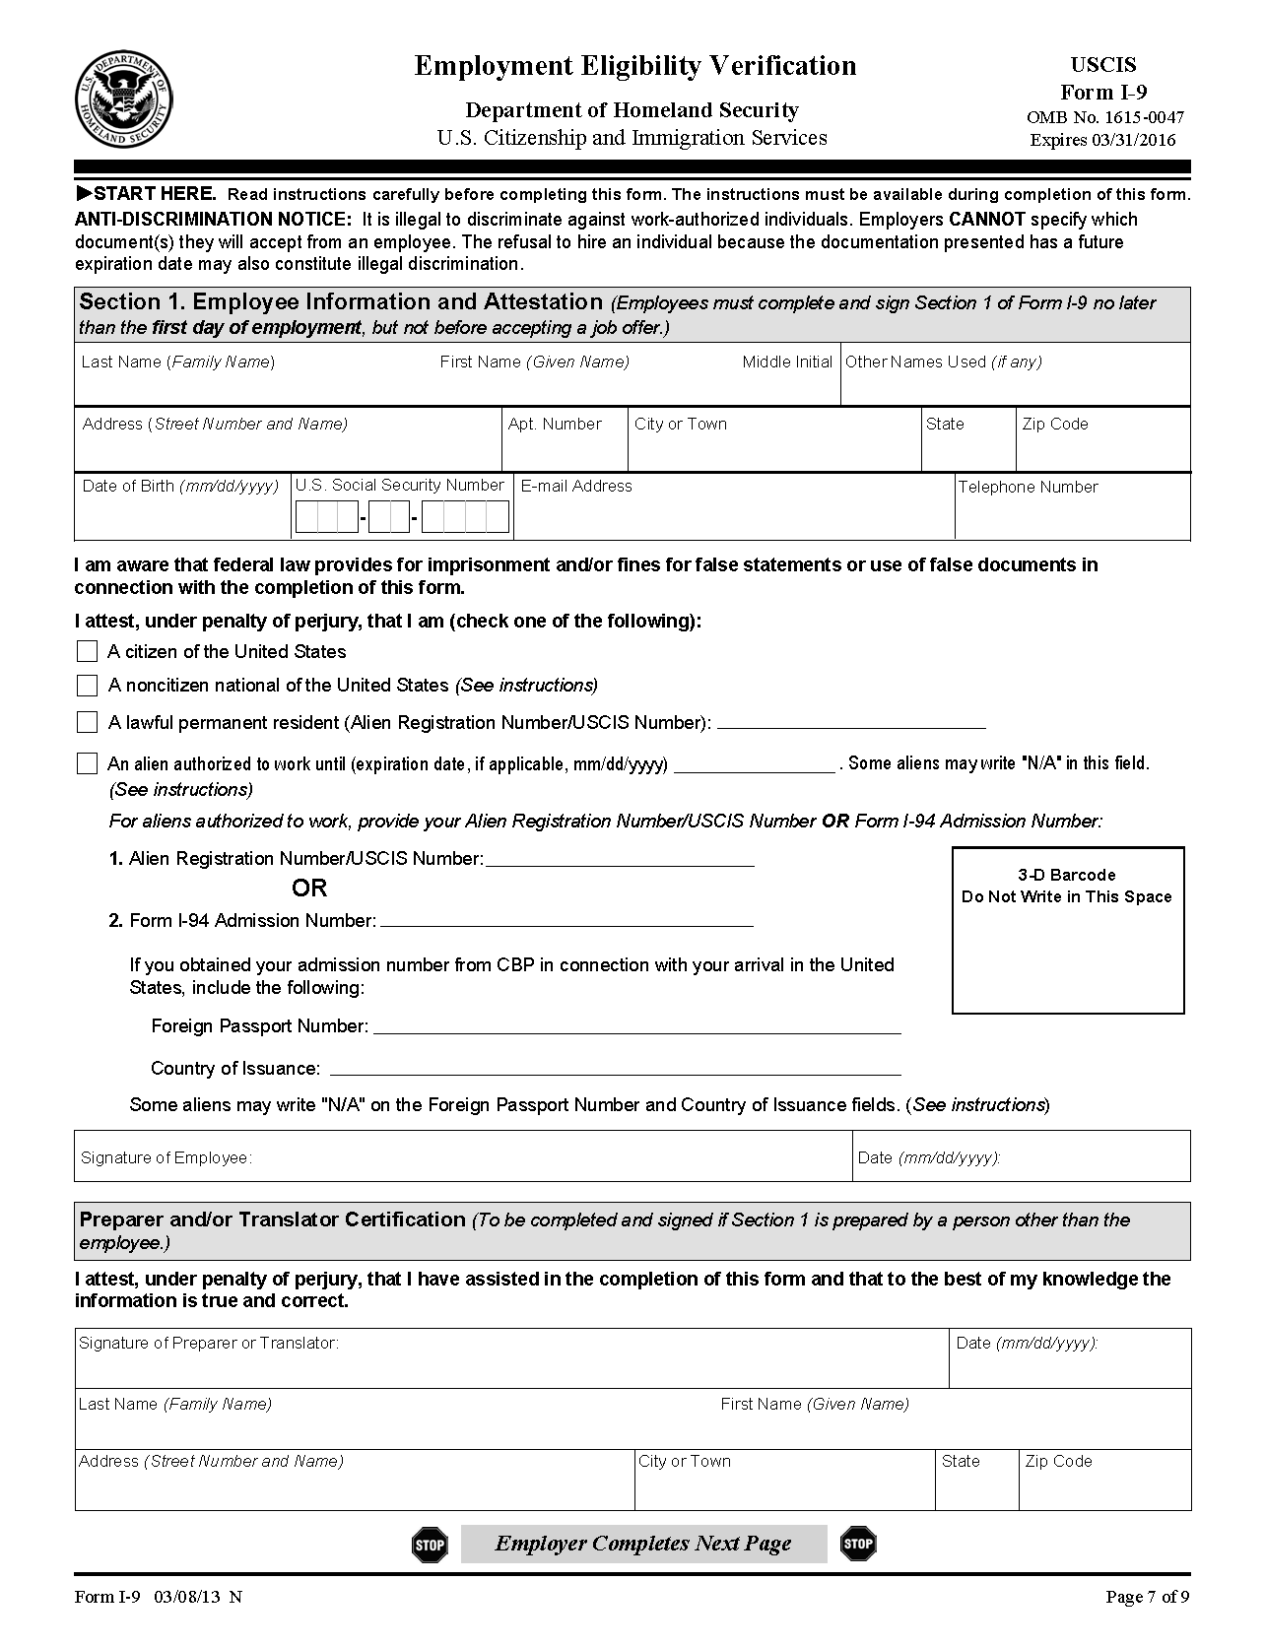
iConnect Employee Onboarding
Create a positive new hire experience with iConnect.
Manage all new hire paperwork online in the Secure Applicant Portal.
iConnect includes I9s, W4s, and State Tax Forms.
Secure Electronic Signature
8

Slide 10
iConnect Internal Forms Creation
Create your Best Practices for interviews
Phone Screen Questionnaires
Requests for additional information
Why selecting candidate
And more. . .
9

Slide 11
iRecruit New Look Dashboard 2016

Slide 12
Smartphone View

